Slide 1
Map building using swarm intelligence
by
Stefan Klaus
stk4@aber.ac.uk

Slide 2
Criteria of the project
Deployment
Accurate mapping
Autonomous area exploration
Communication

Slide 3
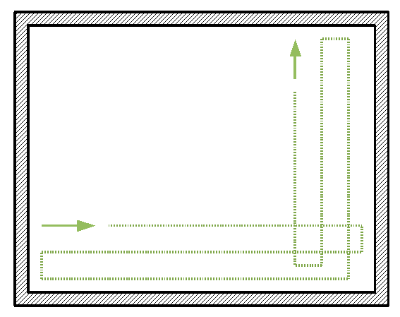
Deployment Method

Slide 4
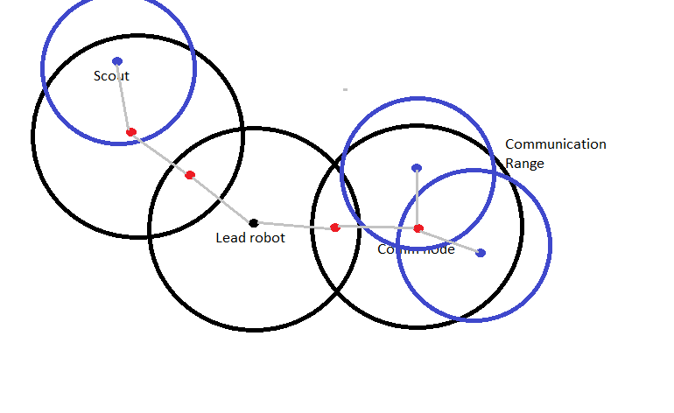
Communication pattern

Slide 5
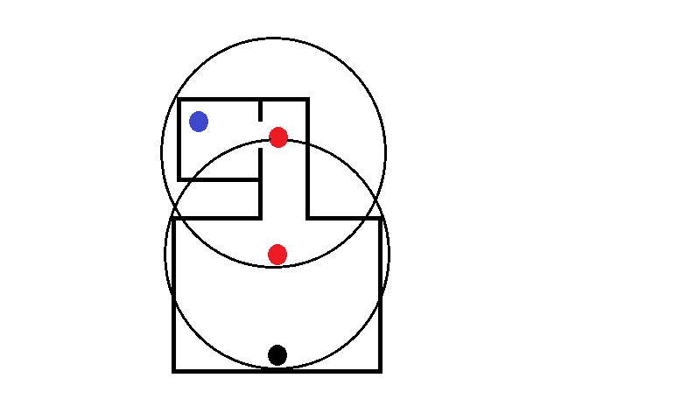
Communication restrictions

Slide 6

Final Environment

Slide 7
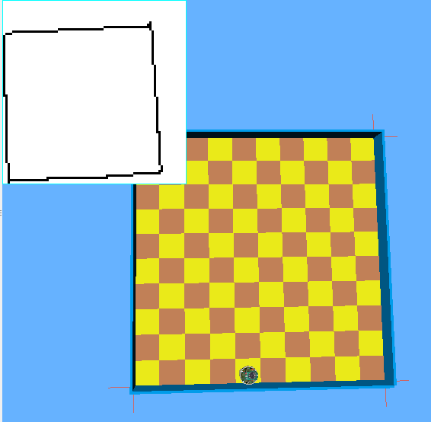
What works now

Slide 8
What is left to do
Make deployment method more effective
Clear up the occupancy grid
multi robot usage (also includes communication)
AI method to find unexplored areas

